Slide 1


JLR VPD EDS
Heating Element
(FY 2025-26)
10-Sept-2025

Slide 2
Change history
Issue | Description | Date | Owner
01 | New Document | 31-12-2025 | Vyshak PV / Moinkhan S/ Akash H

Slide 3
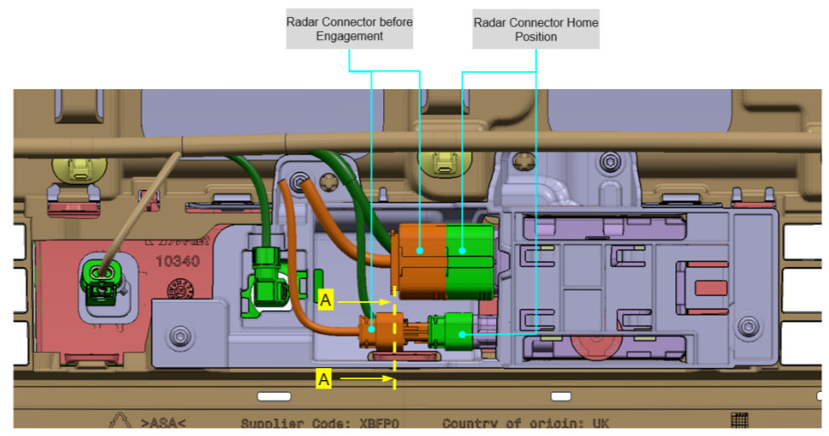
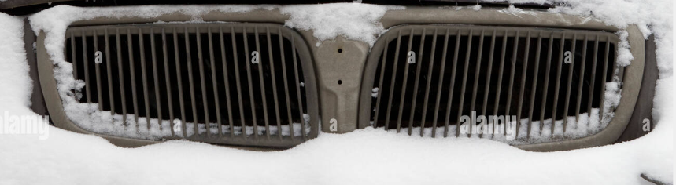
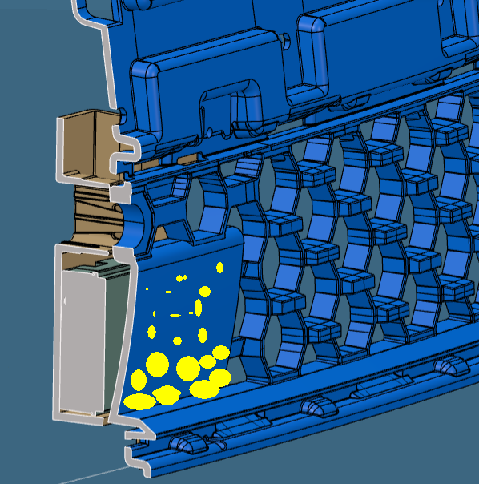
Concept
ICE ACCUMULATION CONCERN
REQUIREMENT
Radome image to understand Snow Accumulation Concern
1. Due to inward profile of grille leap at ADAS area there are chances of snow accumulation, due to which efficiency of radar might get reduced.
2. Snow accumulation assumptions highlighted in yellow colour.
Requirement :- to introduce new part heating element to melt snow.
Constraints:- packaging seems very close with current position (refer next slide) of ADAS and radar bracket (screenshot highlighted next slide).

Slide 4
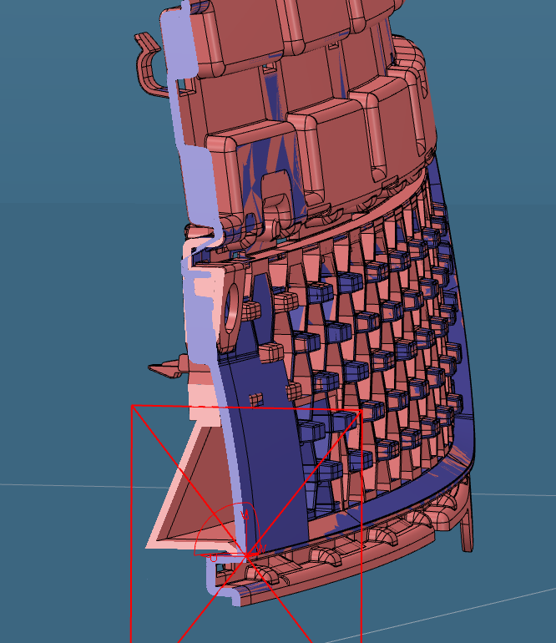
Concept
INITIAL PROPOSAL GIVEN TO AVOID TOOL COST
BUMPER SKIN
ADAS BRACKET
EXISTING GRILLE SURFACE
PROPOSED GRILLE SURFACE
ADAS FOV
ADAS Unit
FINISHERS
Bumper Beam
LOWER GRILLE
Initial Proposal can be shared with Design Team ::
Profile created outward to avoid Snow accumulation to improve ADAS efficiency.
Heating Element need to be incorporated at the radome area If the style modification proposal is not so feasible considering the theme ,

Slide 5
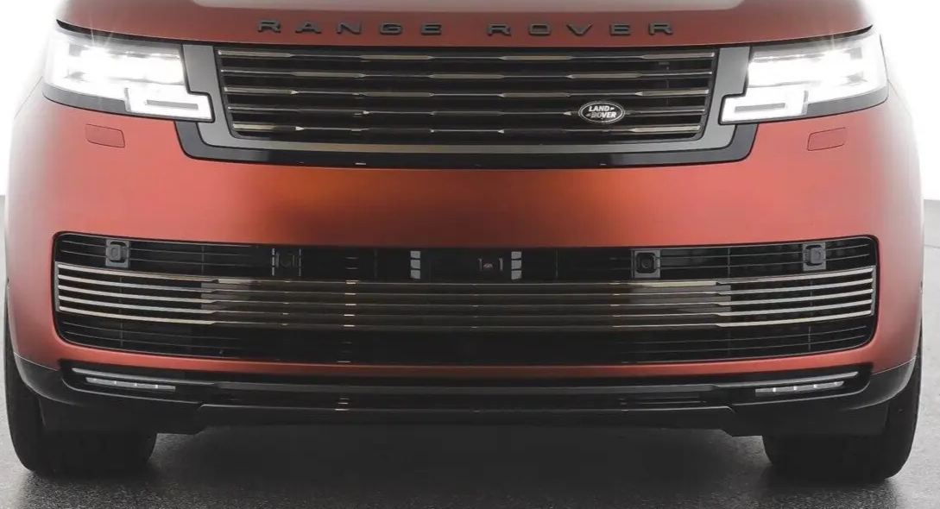
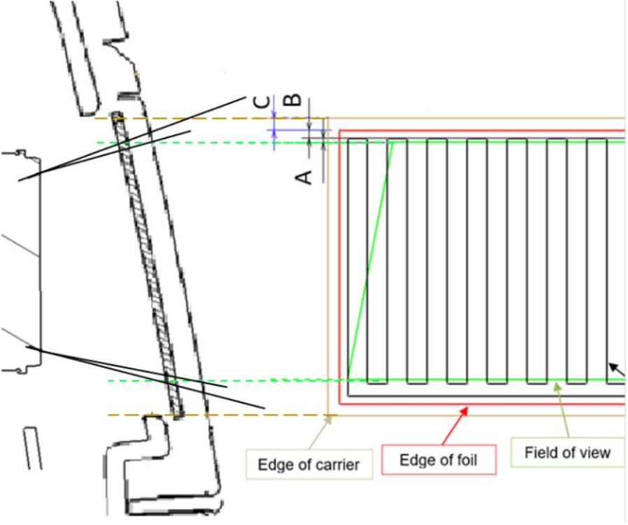
Heating element :: Packaging Requirements
Radome Area
A
A
Heating Element
Heating Wires shall run vertical in carline inside the Field of View
ensure Field of View accounts for radar positional tolerance
Heating Wires shall remain vertical for at least A = 1mm outside of the Field of View
The edge of the foil shall be a minimum of B = 2mm outside of the heating wires
Edge of the carrier to any other mating part feature (e.g. hole, rib, screw boss) shall have a clearance of 1mm within the assembly
The min distance between foil edge & Carrier edge ie C=1.4mm
Foil shall be away from any parting line by at least 0.5mm for parts over 800mm this value has to be confirmed with supplier
Total thickness of the Carrier and Mating part shall be reviewed for radar attenuation mitigation.
ADAS Unit
Section A-A

Slide 6
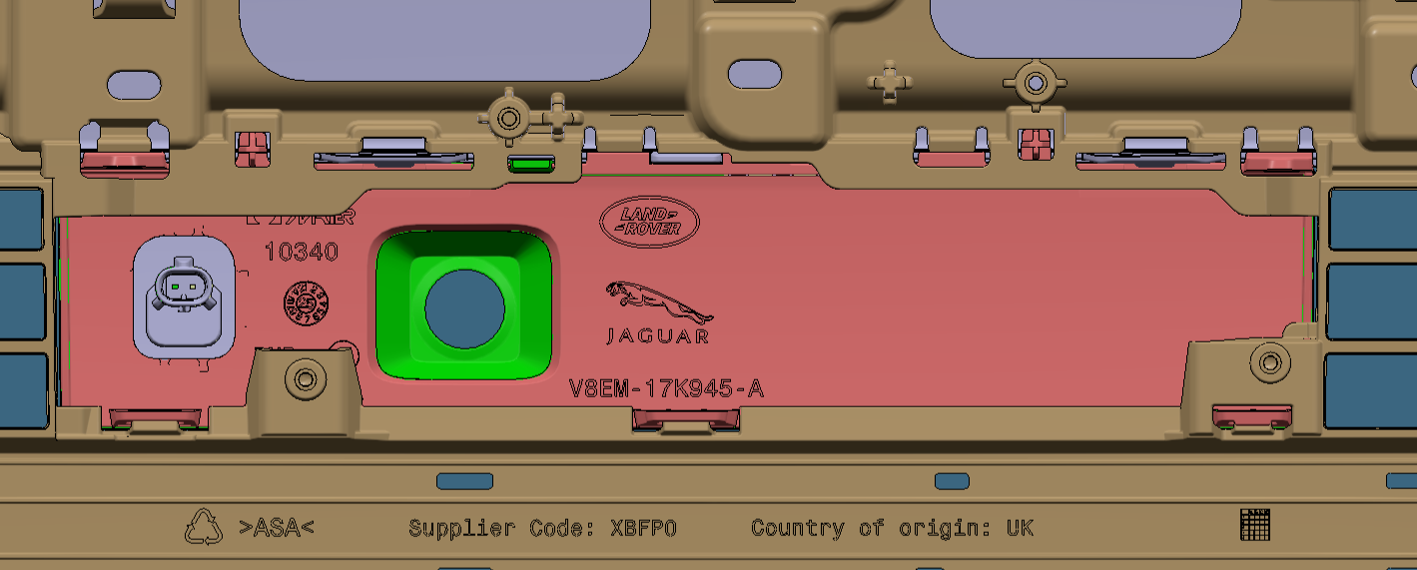
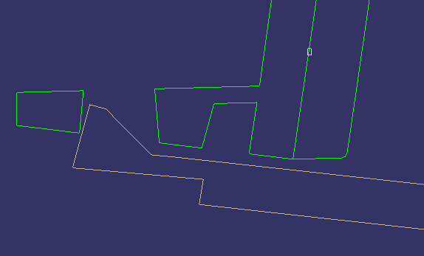
Heating element :: Packaging Requirements / reference
Locating & mounting scheme is highlighted in image from reference program.
It’s recommended to use snap mounting for the serviceability.
Ref. EI_V8EM-17K945-AA--L460 SV 28 MY FR BMPRLWG GRL
Mounting Snap :: 7 Nos.
Locators :: 2 Nos.
Radome Cover
Mounting Snap
FR LWR GRL

Slide 7
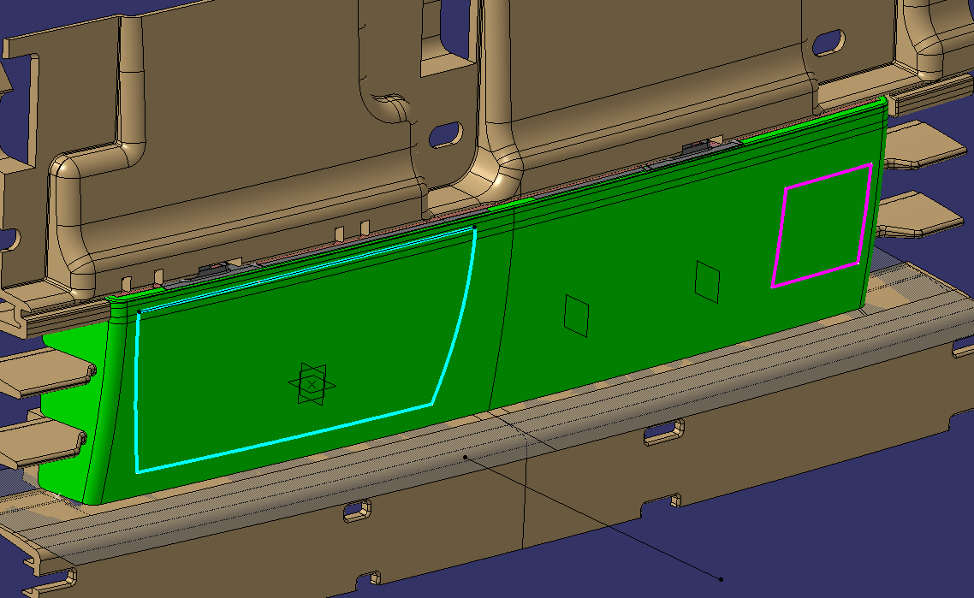
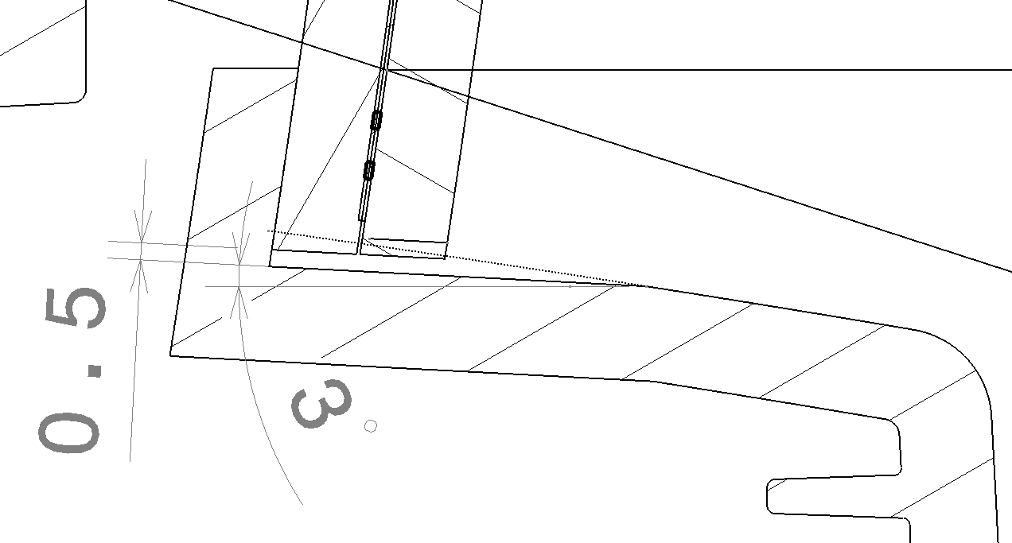
Heating element :: Packaging Requirements
5.8mm
A
A
Thickness Consideration ::
  Part thickness is 5.8mm
  (Radome Aesthetical Portion 3.1mm thk
  + Radome Technical Portion 2.7mm thk )
Material Consideration ::
  PC+ABS
Section A-A
A 0,5mm GAP is required between the grille and the carrier as shown in section as per supplier input. :: It’s need to be approved from JLR design team & DVA

Slide 8
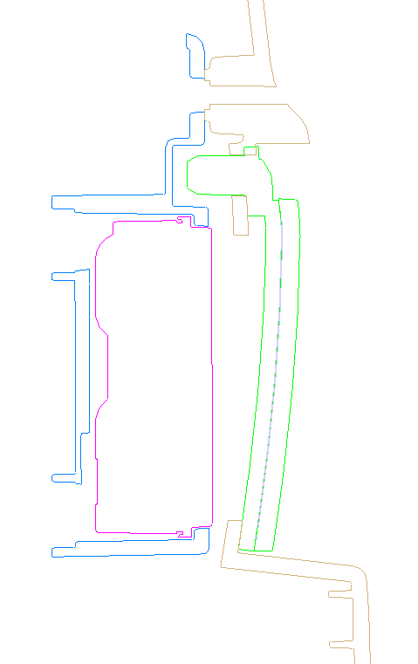
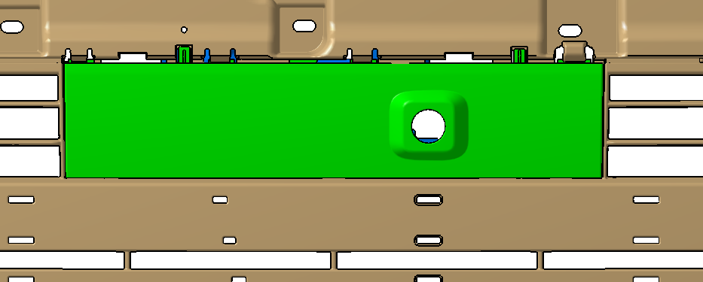
Heating element :: Packaging Requirements / reference
ADAS BRACKET
Radome Cover
ADAS FOV
ADAS Unit
LOWER GRILLE

Slide 9
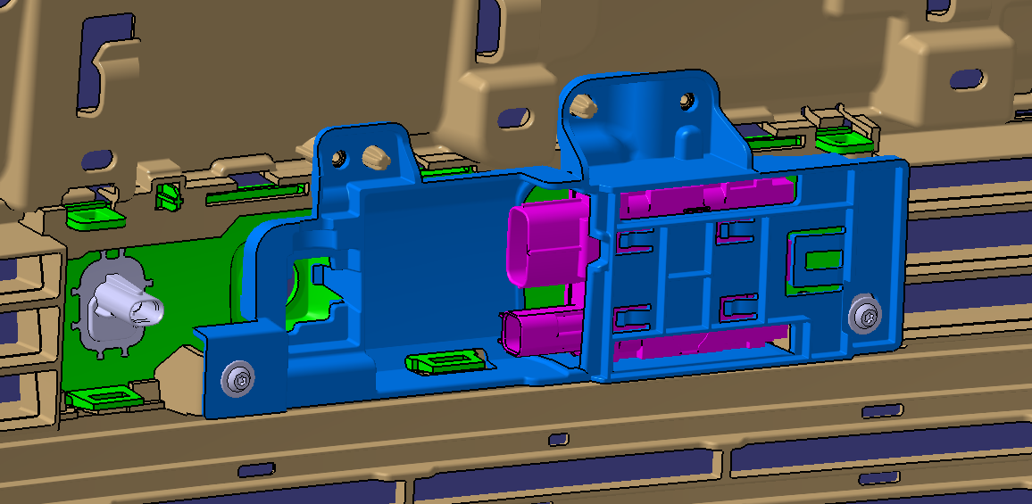
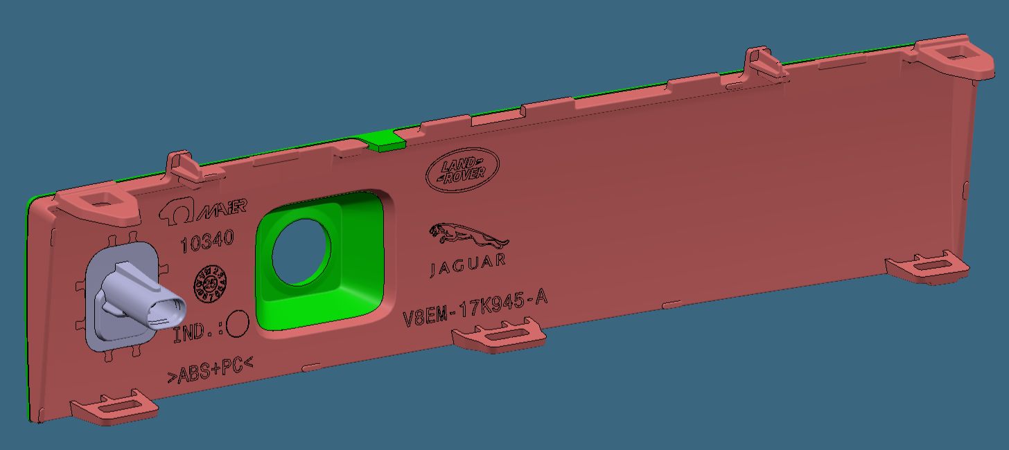
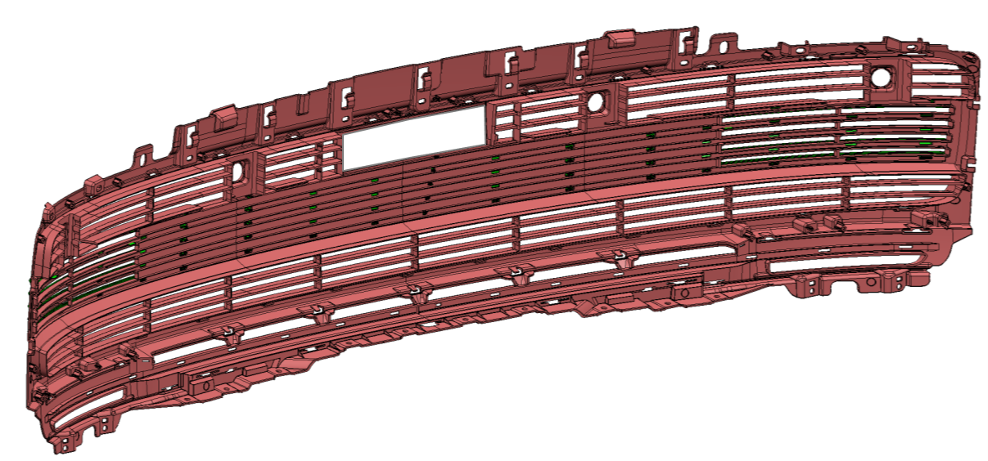
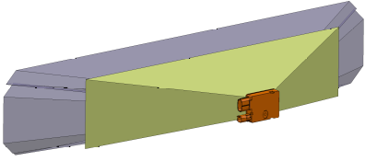
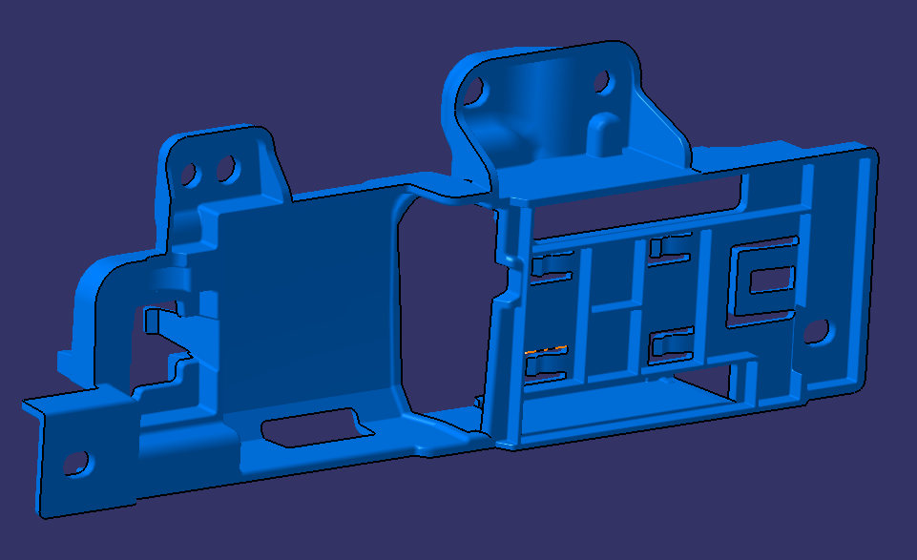
Assembly Flight Path:
Radome Cover + Heating Element
LOWER GRILLE
ADAS Unit
ADAS unit assembly flight path:
ADAS unit will mount on ADAS bracket.
Heating Element gets In molded with Radome Cover. :: will be fitted from front side of LWR GRL
ADAS and ADAS Bracket will mount on Lower Grille in X :: will be fitted from back side of LWR GRL
FR Camera
ADAS MTG Bracker

Slide 10
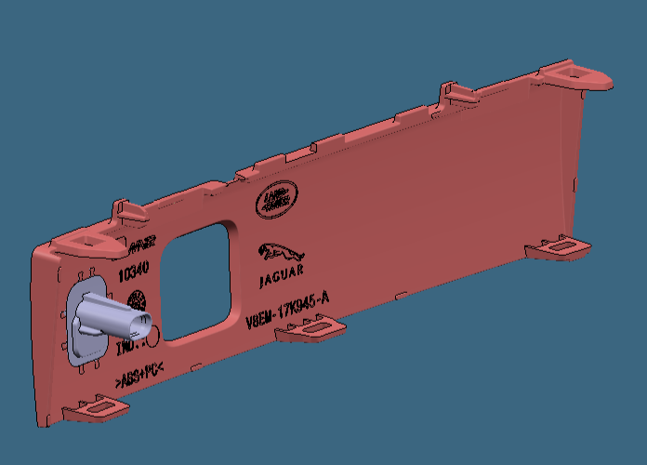
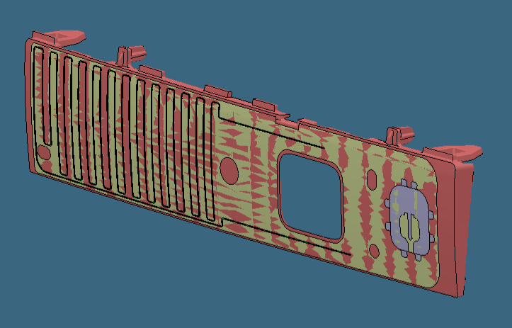
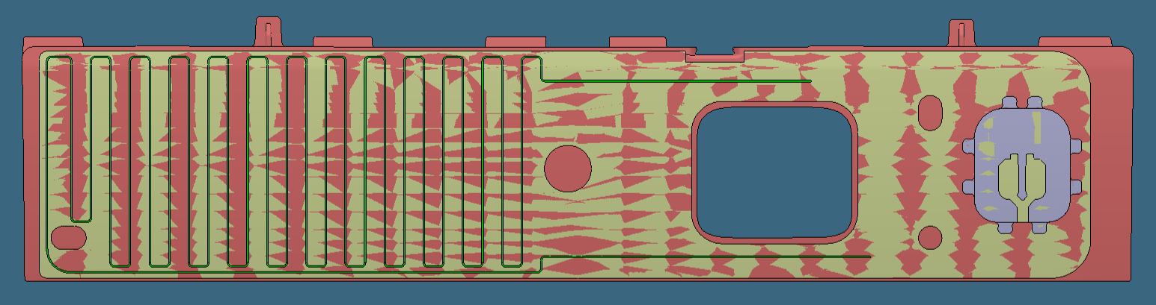
Heating element :: Manufacturing Process
Heating element copper wire is shown in image for reference.
This portion of Radome Cover will be formed in the 1st stage of 2K-Injection moulding process
FOIL
COPPER WIRES
CONNECTOR PORT
REFER NEXT SLIDE

Slide 11
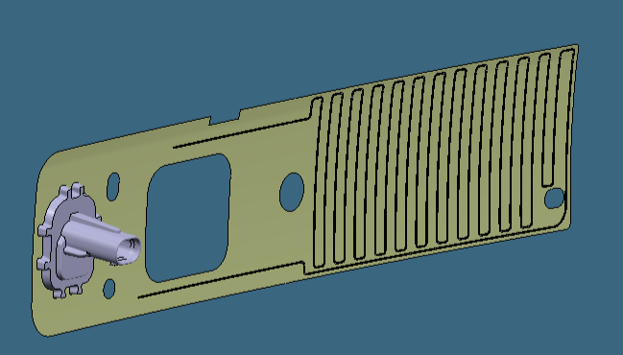
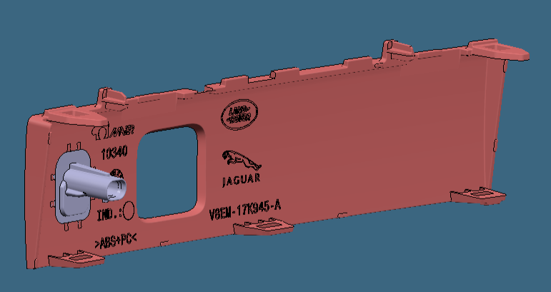
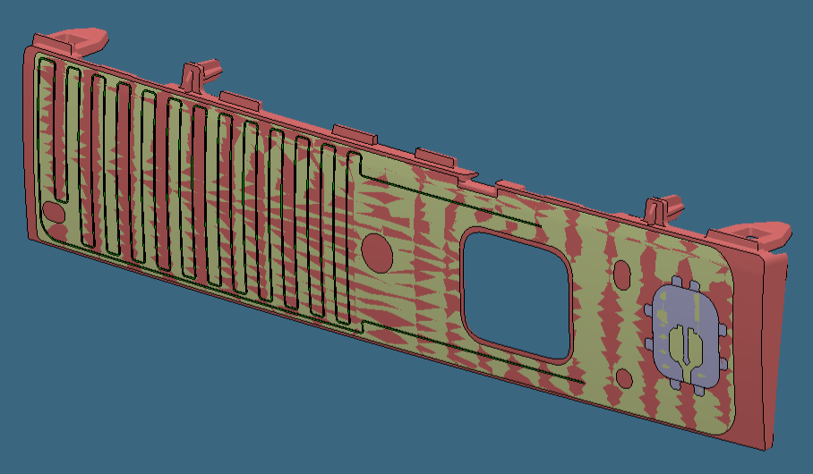
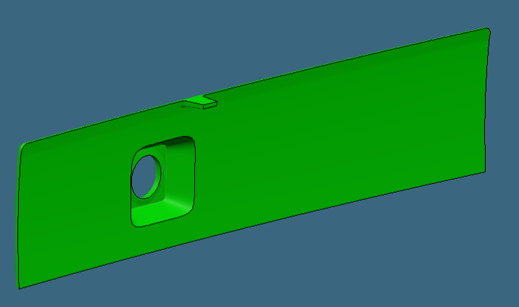
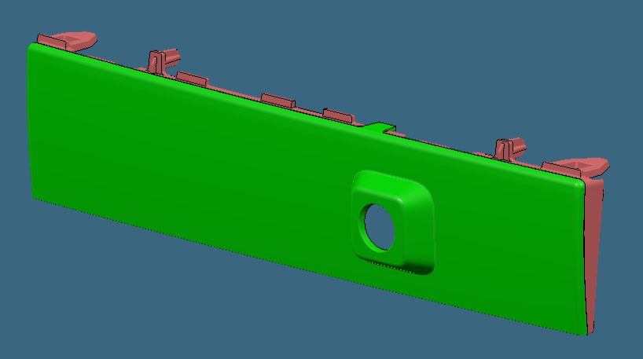
Heating element :: Moulding Process
STAGE :: 1 (Over Moulding + 2K 1st Half)
Radome Cover_MTG/Technical Portion
Material :: PC+ABS
Heating Element will be over moulded in the 2K moulding 1st stage.
Heating Element
(Copper Wire + Foil) will be placed in cavity
STAGE :: 2 (2K Moulding 2nd Half)
Radome Cover_Aesthetical/style Portion
Material :: PC+ABS
will be moulded in the 2K moulding 2nd stage.
Radome Cover Part
Will be snapped on LWR Grill
Here it’s a combination of Over Moulding & 2K Moulding to keep the heating element in the middle of Radome Cover

Slide 12
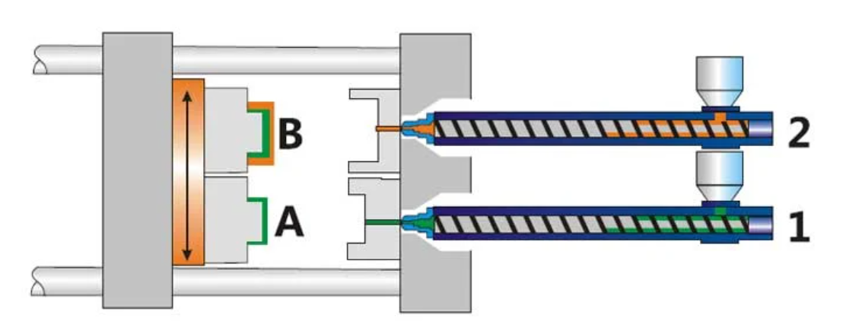
2K Moulding Process :: Reference
180Deg Rotating Core Half
1St Moulding Cavity
2nd Moulding Cavity

